Slide 1
Learning with Bayesian Networks
Author: David Heckerman
Presented by Yan Zhang
April 24 2006

Slide 2
Outline
Bayesian Approach
  Bayes Therom
  Bayesian vs. classical probability methods
  coin toss – an example
Bayesian Network
  Structure
  Inference
  Learning Probabilities
  Learning the Network Structure
  Two coin toss – an example
Conclusions
Exam Questions
Notes:
A BN is a graphical model for probabilistic relationship among a set of variables. It has become a popular representation for encoding uncertain knowledge in many applications, including medical diagnosis system, gene regulatory networks, etc. The paper I goanna present today is a very good entry level tutorial, which introduces many topics of BNs. In my talk today, I will mainly focus on several fundamental topics, which are outlined here. Firstly, I will give you a review of bayesian approach, compare the difference between bayesian method and classical probability method, and give you an example as an illustration of bayesian method. After that, I will spend most of time on the several topics on BNs, including its structure, the inference in a BN, How to learn parameters and structures in BNs, etc. In the end I will provide a summary and discuss our exam questions.

Slide 3


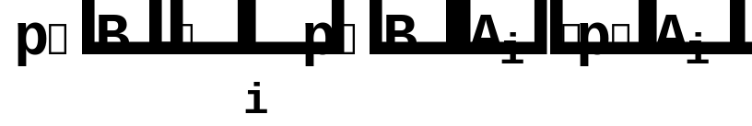
Bayes Theorem
where
Or
p(|D)= p(|D)p()/p(D)
p(S^{h}|D)=p(D|S^{h})p(S^{h})/p(D)
Notes:
I think all of you have already seen this bayes theorem before. It states that the probability of hypothesis A given the observed evidence B can be calculated from this equation. If A is a contiguous variable, p(B) can be calculated by integrating over A; If A is a discrete variable, p(B) can be calculated by summing over all possible Ais. Instead of using A and B, we sometimes use other notations, which are more meaningful under different context. For example, in this equation, theta is a parameter or a vector of parameters of some pdf, from which D is generated. In this equation, Sh represents some network structure of a bayesian network. We will come back to these equations at a later stage when I give you examples. Specifically, the evidence B represents data items we collected, A is some hypothesis we want to update given the observed data, p(B|A) is the likelihood function of B, p(A) is the prior probability of A, p(B) is the probability of data.

Slide 4
Bayesian vs. the Classical Approach
The Bayesian probability of an event x, represents the person’s degree of belief or confidence in that event’s occurrence based on prior and observed facts.
Classical probability refers to the true or actual probability of the event and is not concerned with observed behavior.
Notes:
If we make a comparison between bayesian method and classical method, we will notice that …
We will also notice that …
Let me give you an example. I have a coin here. If I toss it, what is the probability of the outcome being a head? Bayesian statisticians and classical statisticians have different logic to think this question. For classical stats, they cannot answer this question before performing precise measurement of this coin’s physical properties. One thing that is certain for they is, this probability is fixed in the range 0 and 1. No matter what observations we will have, this probability will not change. For Bayesian stats, however, they will answer this question just according to their personal belief.

Slide 5
Bayesian vs. the Classical Approach
Bayesian approach restricts its prediction to the next (N+1) occurrence of an event given the observed previous (N) events.
Classical approach is to predict likelihood of any given event regardless of the number of occurrences.
Notes:
When a set of data is collected, say, I have tossed this coin 100 times and got 65 heads, 35 tails. Classical stats will predict the likelihood of any given data. No matter how many heads and tails I have seen in the previous experiment, the probability of the next toss being a head is always theta. On the other hand, bayesian stats will keep updating their belief using the observed data. So, the probability of the next toss being a head could change.

Slide 6
Example
Toss a coin 100 times, denote r.v. X as the outcome of one flip
  p(X=head) =  p(X=tail) =1-
Before doing this experiment, we have some belief in our mind:
  Prior Probability p( |)=beta(  )
  E[]=  Var()=  
Experiment finished
  h = 65, t = 35
p( |D,)= ?
p( |D,)=p(D| )p( |)/p(D|)
=[k₁^{h}(1-^{t}][k₂ (1- ]/k₃
=beta( h t)
E[ D]=   
Notes:
In the following example, I will show you how the bayesian method works in this coin toss problem.

Slide 7
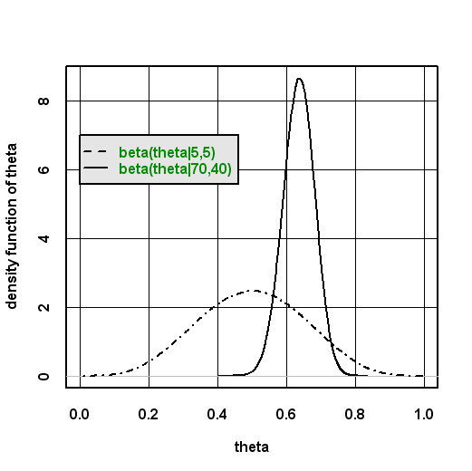
Example

Slide 8
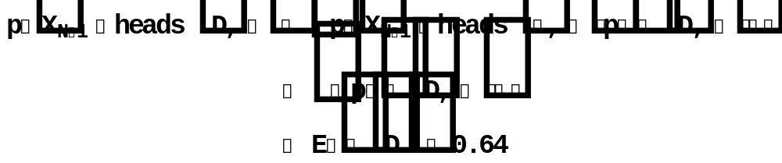
Integration
To find the probability that X_{n+1}=heads, we must integrate over all possible values of  to find the average value of  which yields:

Slide 9
Bayesian Probabilities
Posterior Probability, p( |D,): Probability of a particular value of  given that D has been observed (our final value of ) . In this case  = {D}.
Prior Probability, p( |): Prior Probability of a particular value of  given no observed data (our previous “belief”)
Observed Probability or “Likelihood”, p(D|,): Likelihood of sequence of coin tosses D being observed given that  is a particular value. In this case  = {}.
p(D|): Raw probability of D

Slide 10
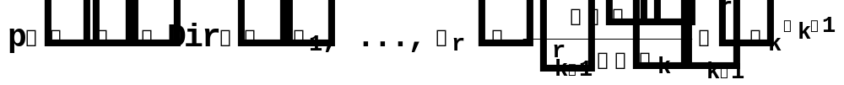
Priors
In the previous example, we used a beta prior to encode the states of a r.v. It is because there are only 2 states/outcomes of the variable X.
In general, if the observed variable X is discrete, having r possible states {1,…,r}, the likelihood function is given by
p(X=x^{k} | ,)= , where k=1,…,r and  = { ,…, _{r }}, ∑  =1
We use Dirichlet distribution as prior:
And we can derive the posterior distribution

Slide 11
Outline
Bayesian Approach
  Bayes Therom
  Bayesian vs. classical probability methods
  coin toss – an example
Bayesian Network
  Structure
  Inference
  Learning Probabilities
  Learning the Network Structure
  Two coin toss – an example
Conclusions
Exam Questions
Notes:
I have had a review of the bayesian approach. Now, I goanna introduce our main topic BN.

Slide 12
Introduction to Bayesian Networks
Bayesian networks represent an advanced form of general Bayesian probability
A Bayesian network is a graphical model that encodes probabilistic relationships among variables of interest
The model has several advantages for data analysis over rule based decision trees

Slide 13
Advantages of Bayesian Techniques (1)
How do Bayesian techniques compare to other learning models?
Bayesian networks can readily handle incomplete data sets.

Slide 14
Advantages of Bayesian Techniques (2)
Bayesian networks allow one to learn about causal relationships
  We can use observed knowledge to determine the validity of the acyclic graph that represents the Bayesian network.
  Observed knowledge may strengthen or weaken this argument.

Slide 15
Advantages of Bayesian Techniques (3)
Bayesian networks readily facilitate use of prior knowledge
  Construction of prior knowledge is relatively straightforward by constructing “causal” edges between any two factors that are believed to be correlated.
  Causal networks represent prior knowledge where as the weight of the directed edges can be updated in a posterior manner based on new data

Slide 16
Advantages of Bayesian Techniques (4)
Bayesian methods provide an efficient method for preventing the over fitting of data (there is no need for pre-processing).
  Contradictions do not need to be removed from the data.
  Data can be “smoothed” such that all available data can be used

Slide 17
Example Network
Consider a credit fraud network designed to determine the probability of credit fraud based on certain events
Variables include:
  Fraud(f): whether fraud occurred or not
  Gas(g): whether gas was purchased within 24 hours
  Jewelry(J): whether jewelry was purchased in the last 24 hours
  Age(a): Age of card holder
  Sex(s): Sex of card holder
Task of determining which variables to include is not trivial, involves decision analysis.
Notes:
Now I’ll show you an example of how a BN is constructed. Here we consider a credit card fraud detection problem. We begin by determining the variables to model. One possible choice of variables for our problem is F, G, J, A, S; representing whether or not current purchase is fraudulent, whether or not…respectively. Of course, in a realistic problem, we would include many more variables.

Slide 18
Example Network
X₁
X₂
X₃
 | X1 | X2 | X3 | Өijk
 | yes | <30 | m | Ө511
 | yes | <30 | f | Ө521
X5 = yes | yes | 30-50 | m | Ө521
 | yes | 30-50 | f | Ө541
 | yes | >50 | m | Ө551
 | yes | >50 | f | Ө561
 | no
 | … |  |  | Ө5 12 1
X5 = no | yes | <30 | m | Ө512
 | …
Fraud
Age
Sex
X₄
X₅
Gas
Jewelry
A set of Variables X={X₁,…, X_{n}}
A Network Structure
Conditional Probability Table (CPT)

Slide 19
Example Network
X₁
X₂
X₃
Using the graph of expected causes, we can check for conditional independence of the following probabilities given initial sample data
Fraud
Age
Sex
X₄
X₅
Gas
Jewelry
p(a|f) = p(a)
p(s|f,a) = p(s)
p(g|f,a, s) = p(g|f)
p(j|f,a,s,g) = p(j|f,a,s)

Slide 20
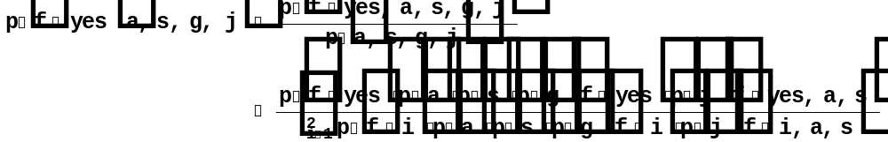
Inference in a Bayesian Network
To determine various probabilities of interests from the model
Probabilistic inference
  The computation of a probability of interest given a model
Notes:
Once we have constructed a BN, we usually need to determine various probabilities of interests from the model. For example, in our problem concerning fraud detection, we want to know the probability of fraud given observations of the other variables. This probability is not stored directly in the model, and hence needs to be computed. In general, the computation of a probability of interest given a model is known as probabilistic inference.

Slide 21
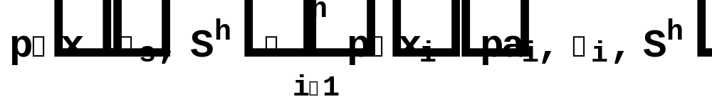
Learning Probabilities in a Bayesian Network
X₁
X₂
X₃
 | X1 | X2 | X3 | Өijk
 | yes | <30 | m | Ө511
 | yes | <30 | f | Ө521
X5 = yes | yes | 30-50 | m | Ө521
 | yes | 30-50 | f | Ө541
 | yes | >50 | m | Ө551
 | yes | >50 | f | Ө561
 | no
 | … |  |  | Ө5 12 1
X5 = no | yes | <30 | m | Ө512
 | …
Fraud
Age
Sex
X₄
X₅
Gas
Jewelry
The physical joint probability distribution for X=(X₁… X₅) can be encoded as following expression
where _{s} =(₁ … _{n} )
Notes:
Having discussed the problem of the inference in a BN, I’ll talk about how to refine the local probability distributions of a BN given data. The physical joint probability distribution for X=(X₁… X₅) can be encoded as following expression. Where _{i} is the vector of parameters for the distribution p(xi|pai, _{i} , sh),
_{s} is a vector of parameters (₁ … _{n} ). In addition, we assume that we have a random sample D={d_1…d_N} from the physical joint probability distribution of X.

Slide 22

Learning Probabilities in a Bayesian Network
As new data come, the probabilities in CPTs need to be updated
Then we can update each vector of parameters _{ij} independently, just as one-variable case.
Assuming each vector _{ij} has the prior distribution Dir(_{ij} _{ij1},…, _{ijri})
Posterior distribution
p_{ij}|D,S^{h})=Dir(_{ij}|_{ij1}+N_{ij1} , …, _{ijri}+N_{ijri})
Where N_{ijk} is the number of cases in D in which X_{i}=x_{i}^{k} and Pa_{i}=pa_{i}^{j}
Notes:
Parameter independence. The problem of learning probabilities in a BN can now be stated simply: Given a random sample D, computer the posterior distribution of theta

Slide 23

Learning the Network Structure
Sometimes the causal relations are not obvious, so that we are uncertain with the network structure
Theoretically, we can use bayesian approach to get the posterior distribution of the network structure
Unfortunately, the number of possible network structure increase exponentially with n – the number of nodes
Notes:
Now, let us consider the problem of learning about both the structure and the probabilities of a BN given data. Assuming we think structure can be improved, we must be uncertain about the network structure that encode the physical joint probability distribution for x.

Slide 24
Learning the Network Structure
Model Selection
  To select a “good” model (i.e. the network structure) from all possible models, and use it as if it were the correct model.
Selective Model Averaging
  To select a manageable number of good models from among all possible models and pretend that these models are exhaustive.
Questions
  How do we choose search for good models?
  How do we decide whether or not a model is “Good”?
Notes:
This tutorial introduced the criteria for model selection, I am not going to get into it though. For those of you who are interested in it, you can read through it in detail.

Slide 25
Two Coin Toss Example
S^{h}₁
S^{h}₂
p(H|H) = 0.1
p(T|H) = 0.9
p(H|T) = 0.9
p(T|T) = 0.1
X₁
X₂
X₁
X₂
p(H)=p(T)=0.5
p(H)=p(T)=0.5
Experiment: flip two coins and observe the outcome
We have had two network structures in mind: S^{h}₁ or S^{h}₂
If p(S^{h}₁)=p(S^{h}₂)=0.5
After observing some data, which model is more possible for this collection of data?
Notes:
Here I am goanna give you an example to show how to choose network structure given observed data. I make up this example, which is far from the complex situation in a realistic problem. I just want to let you have a feeling about how it works.

Slide 26

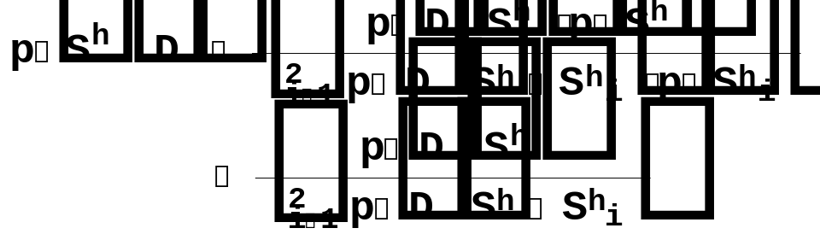

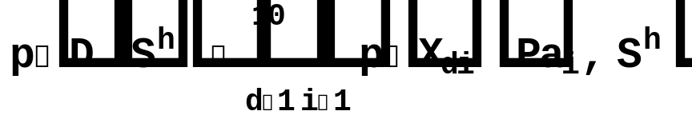
Two Coin Toss Example
 | X₁ | X₂
1 | T | T
2 | T | H
3 | H | T
4 | H | T
5 | H | H
6 | H | T
7 | T | H
8 | T | H
9 | H | T
10 | H | T

Slide 27
Outline
Bayesian Approach
  Bayes Therom
  Bayesian vs. classical probability methods
  coin toss – an example
Bayesian Network
  Structure
  Inference
  Learning Probabilities
  Learning the Network Structure
  Two coin toss – an example
Conclusions
Exam Questions

Slide 28
Conclusions
Bayesian method
Bayesian network
  Structure
  Inference
  Learn parameters and structure
  Advantages
Notes:
Firstly, I reviewed the bayes theorem, and I compared the difference between bayesian method and classical method. I showed a coin toss example to illustrate how to encode the personal belief as the prior information, and how to use the observed data to update the belief. Secondly, I introduced several fundamental topics in BNs. I introduced the structure of a BN: variables, structure, CPT. How to make inference in BN. How to update the local probabilities in CPT. I briefly mentioned how to refine the network structures: model selection and model averaging. I also talked the advantages of BNs, which include

Slide 29
Question1: What is Bayesian Probability?
A person’s degree of belief in a certain event
i.e. Your own degree of certainty that a tossed coin will land “heads”

Slide 30
Question 2: What are the advantages and disadvantages of the Bayesian and classical approaches to probability?
Bayesian Approach:
  +Reflects an expert’s knowledge
  +The belief is kept updating when new data item arrives
  - Arbitrary (More subjective)
Classical Probability:
  +Objective and unbiased
  - Generally not available
    It takes a long time to measure the object’s physical characteristics

Slide 31
Question 3: Mention at least 3 Advantages of Bayesian analysis
Handle incomplete data sets
Learning about causal relationships
Combine domain knowledge and data
Avoid over fitting

Slide 32
The End
Any Questions?

